Slide 1
BIG MART SALES PREDICTION
Group No: 09
Group Members:
201P049 | Utsav Kuntalwad | 22
201P037 | Srushti Sawant | 37
201P013 | Mayur Kyatham | 23
201P041 | Prerna Shakwar | 57
Project Guide:
Prof. Vishal Patil

Slide 2
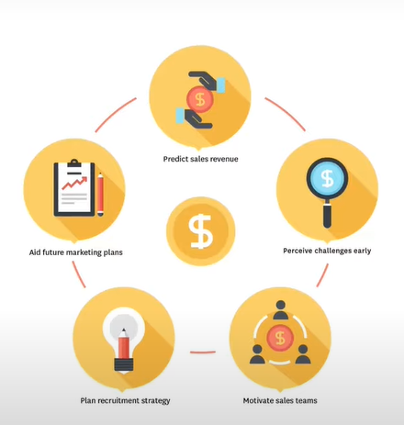
Problem statement Nowadays, shopping malls and Big Marts keep track of individual item sales data in order to forecast future client demand and adjust inventory management. In a data warehouse, these data stores hold a significant amount of consumer information and particular item details. By mining the data store from the data warehouse, more anomalies and common patterns can be discovered.

Slide 3
Flow of our Project
Collection of Data
Preparation of Data
EDA (Pandas-Profiling , Klib)
Data Cleaning
Pre-Processing (Label encoding, splitting , Standardization)
Model building (Linear Regression, Random Forest Regressor , XG Boost Regressor)
Hyperparameter Tuning
Deployment

Slide 4
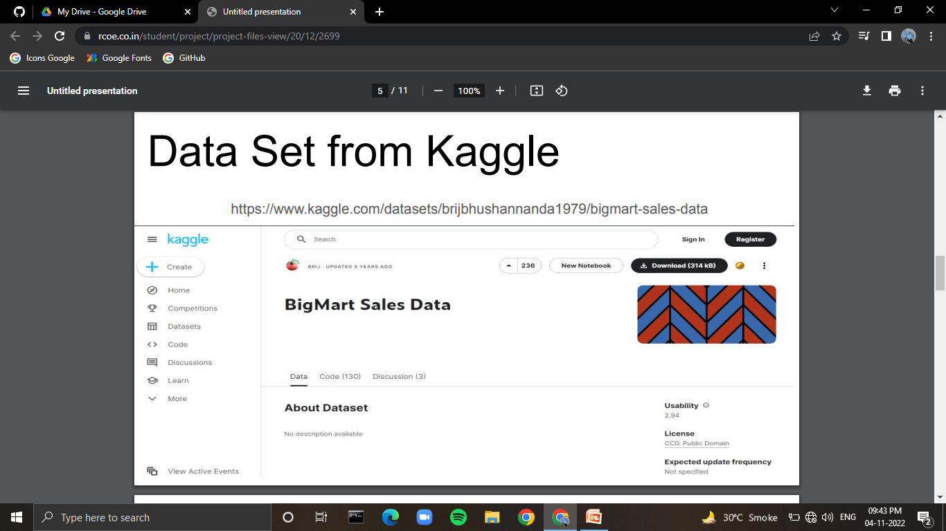
Data Set from Kaggle

Slide 5
Preparation of Data
Checking the number of null values in the dataset.
Seeing the type of target (object, category, numerical etc)
Replacing numerical columns null values with mean imputation(Item_Weight)
Replacing categorical columns null values with mode imputation (Outlet_Size)
Removing waste variables (Item identifier and outlet identifier)

Slide 6
Exploratory Data Analysis (EDA)
Pandas Profiling - Allows us to become familiar with our data by exploring it from multiple angles through statistics data visualizations and data summaries.
Klib - Importing , cleaning , analyzing and pre processing data.

Slide 7
Data Cleaning
Performs Datacleaning (drop duplicates & empty rows/cols, adjust dtypes)
Cleans and Standardizes column names, also called inside data_cleaning()
Converts existing to more efficient dtypes, also called inside data_cleaning()

Slide 8
Pre-Processing task
Label Encoding - Label Encoding refers to converting the labels into a numeric form so as to convert them into the machine-readable form. Machine learning algorithms can then decide in a better way how those labels must be operated. It is an important pre-processing step for the structured dataset in supervised learning.
Splitting train and test data - The train-test split is a technique for evaluating the performance of a machine learning algorithm. It can be used for classification or regression problems and can be used for any supervised learning algorithm. The procedure involves taking a dataset and dividing it into two subsets.
Standardization - Standardization of datasets is a common requirement for many machine learning estimators implemented in scikit-learn; they might behave badly if the individual features do not more or less look like standard normally distributed data: Gaussian with zero mean and unit variance.

Slide 9
Model Building
Linear Regression - It can be referred to as a parametric ML technique which is used to predict a continuous or dependent variable since a dataset of independent variables is provided. This technique is said to be parametric as different predictions are made based on the dataset.
Random Forest Regressor - A random forest is a meta estimator that fits a number of classifying decision trees on various sub-samples of the dataset and uses averaging to improve the predictive accuracy and control over-fitting. The sub-sample size is controlled with the max_samples parameter if bootstrap=True (default), otherwise the whole dataset is used to build each tree.
XG Boost Regressor - XGBoost is a popular and efficient open-source implementation of the gradient boosted trees algorithm.

Slide 10
Hyperparameter Tuning
Hyperparameter tuning relies more on experimental results than theory, and thus the best method to determine the optimal settings is to try many different combinations evaluate the performance of each model.
However, evaluating each model only on the training set can lead to one of the most fundamental problems in machine learning: overfitting. If we optimize the model for the training data, then our model will score very well on the training set, but will not be able to generalize to new data, such as in a test set.
When a model performs highly on the training set but poorly on the test set, this is known as overfitting, or essentially creating a model that knows the training set very well but cannot be applied to new problems. It’s like a student who has memorized the simple problems in the textbook but has no idea how to apply concepts in the messy real world.
An overfit model may look impressive on the training set, but will be useless in a real application. Therefore, the standard procedure for hyperparameter optimization accounts for overfitting through cross validation.

Slide 11
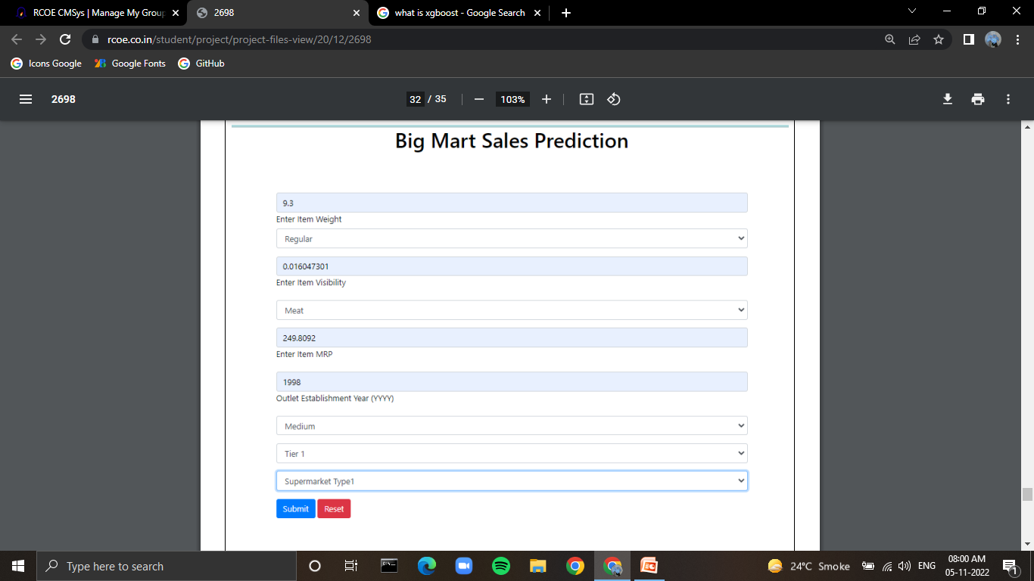
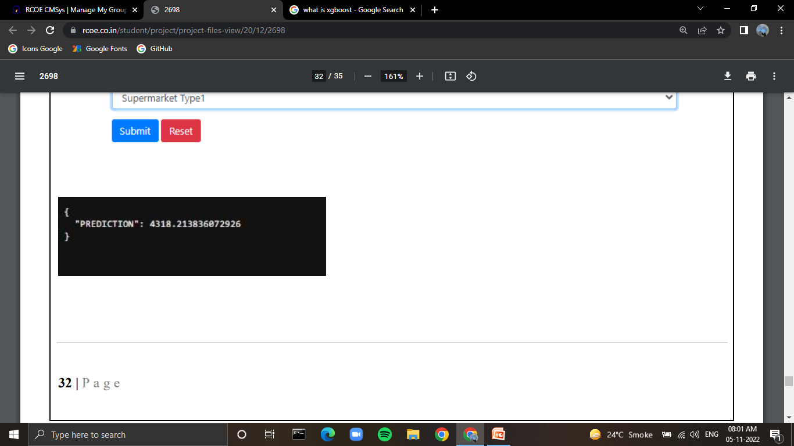
Deployment

Slide 12
THANK YOU !

